Slide 1

CAP615 PROGRAMMING IN JAVA
Lecture #3

Slide 2
Today’s topics
Introduction to Java : basic java concepts:
Introduction about the java programming development tools,
Java keywords,
variables,
data types,
operators and
control statements

Slide 3
Java defines 8 primitive data types : byte, short, int, long, char, float, double and boolean.
They are divided into the following categories:
Integers
Floating Point Numbers
Characters
Boolean Type

Slide 4
Integers:
These are of four types: byte, short, int, long.
It is important to note that these are signed positive and negative values. Signed integers are stored in a computer using 2’s complement. It consist both negative and positive values but in different formats like (-1 to -128) or (0 to +127). An unsigned integer can hold a larger positive value, and no negative value like (0 to 255). Unlike C++ there is no unsigned integer in Java.

Slide 5
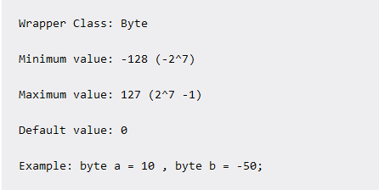
byte:
Byte data type is an 8-bit signed two’s complement integer.

Slide 6
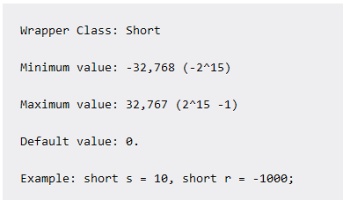
short:
Short data type is a 16-bit signed two’s complement integer.

Slide 7
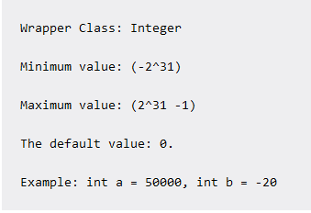
int:
int data type is a 32-bit signed two’s complement integer.

Slide 8
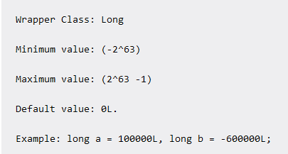
long:
Long data type is a 64-bit signed two’s complement integer.

Slide 9
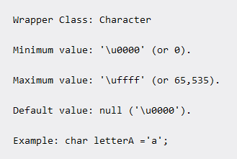
Character:
Java uses a UNICODE, internationally accepted character set. Char in Java is 16­bits long while that in C/C++ is 8­bits.

Slide 10
Unicode
Unique code for each character
We can use any language character
Can be categories in
UTF-8. UTF-16 and UTF-32
Unicode Transformation Format
UTF-8 means: 2⁸ =256 types of character supported
UTF-16 means: 2¹⁶ =65536 types of characters
UTF-32 means: 2³² = 4294967296 types of charcters
As compare with ASCII (American Standard Code Information Interchange) , ASCII support only 256

Slide 11
To find size of datatypes
class MainClass
{
public static void main(String []args)
{
System.out.println("Size of int: " + (Integer.SIZE/8) + " bytes.");
System.out.println("Size of long: " + (Long.SIZE/8) + " bytes.");
System.out.println("Size of char: " + (Character.SIZE/8) + " bytes.");
System.out.println("Size of float: " + (Float.SIZE/8) + " bytes.");
System.out.println("Size of double: " + (Double.SIZE/8) + " bytes.");
}
}

Slide 12

Operators

Slide 13
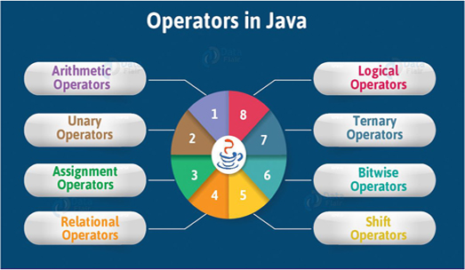

Slide 14
Bitwise operators
Operator | Description
& | AND Operator
| | OR Operator
^ | XOR Operator
~ | Ones Complement Operator
<< | Left Shift Operator
>> | Right Shift Operator

Slide 15
What will be output?
class MainClass
{
public static void main(String []args)
{
int a=12,b=25;
System.out.println(a&b);
}
}
4
6
8
10

Slide 16
AND Operator (&)
If both side bit is on result will be On
a | b | a & b
0 | 0 | 0
0 | 1 | 0
1 | 0 | 0
1 | 1 | 1

Slide 17
Steps to solve:-
a = 12 (find binary form:1100 )
b = 25 (find binary form:11001)
How to find Binary:
64 32 16 8 4 2 1
0 1 1 0 0
12
25
8
1 1 0 0 1
1 0 0 0

Slide 18
a & b=
01100 (12)
11001 (25)
01000 (8) Ans.

Slide 19
OR Operator (|)
If any side bit is on result will be On
a | b | a | b
0 | 0 | 0
0 | 1 | 1
1 | 0 | 1
1 | 1 | 1

Slide 20
Steps to solve:-
a = 12 (find binary form:1100 )
b = 25 (find binary form:11001)
How to find Binary:
64 32 16 8 4 2 1
0 1 1 0 0
12
25
29
1 1 0 0 1
1 1 1 0 1

Slide 21
a | b=
01100 (12)
11001 (25)
11101 (29) Ans.

Slide 22
XOR Operator (^)
If both side bit is opposite result will be On
a | b | a ^ b
0 | 0 | 0
0 | 1 | 1
1 | 0 | 1
1 | 1 | 0

Slide 23
Steps to solve:-
a = 12 (find binary form:1100 )
b = 25 (find binary form:11001)
How to find Binary:
64 32 16 8 4 2 1
0 1 1 0 0
12
25
21
1 1 0 0 1
1 0 1 0 1

Slide 24
a ^ b=
01100 (12)
11001 (25)
10101 (21) Ans.

Slide 25
Left Shift Operator(<<)
a=10 (1010)
a<<1
1010.0
10100(20) Ans.
a<<2
1010.00
101000(40) Ans.

Slide 26
Right Shift Operator(>>)
a=10 (1010)
a>>1
1010.
101(5) Ans.
a>>2
1010.
10(2) Ans.

Slide 27
Unary Operators in Java
Java unary operators are the types that need only one operand to perform any operation like increment, decrement, negation, etc. It consists of various arithmetic, logical and other operators that operate on a single operand.

Slide 28
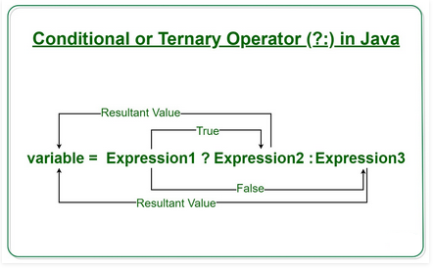
Ternary Operator
Java ternary operator is the only conditional operator that takes three operands. It’s a one-liner replacement for if-then-else statement and used a lot in Java programming.

Slide 29


